Slide 1

We work ensure a safer internet experience for everyone

Slide 2
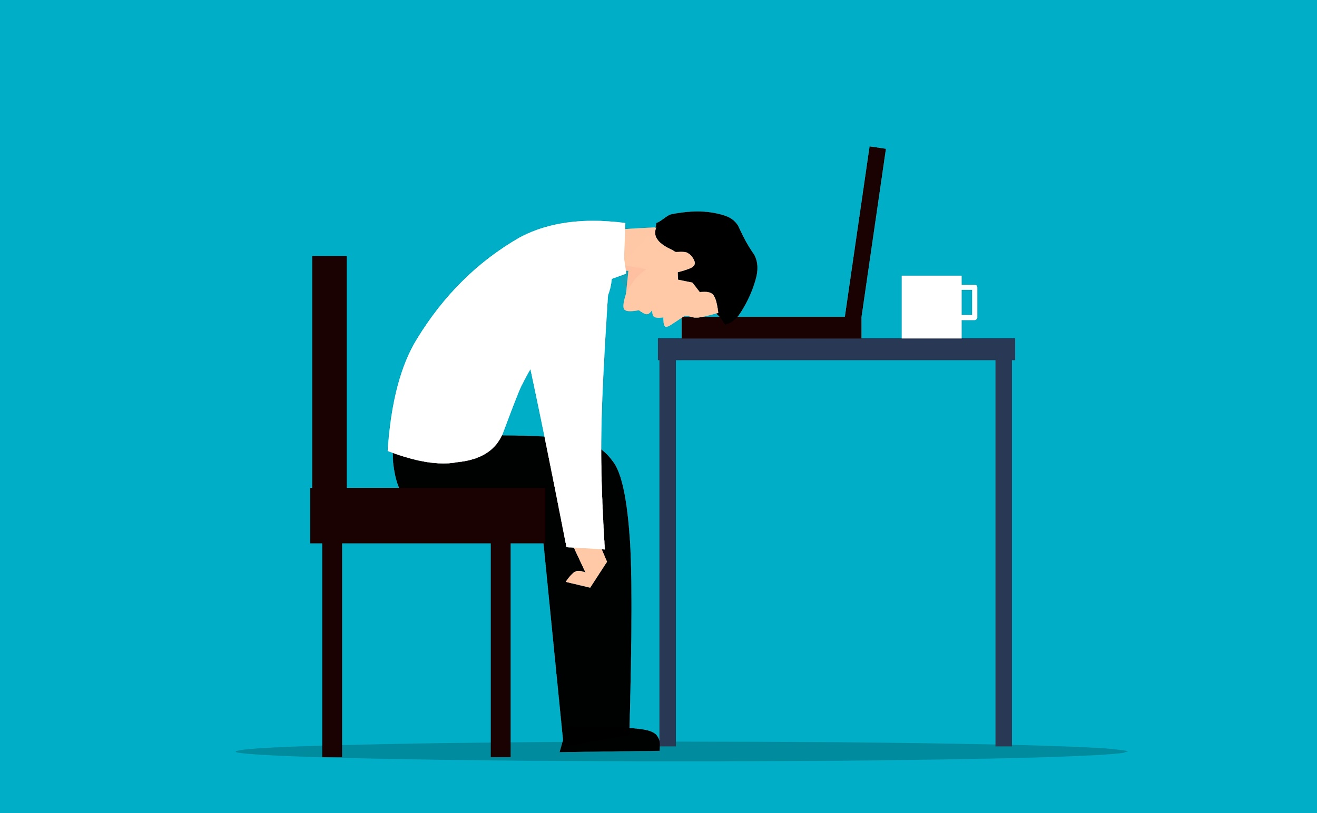
Cyber Harassment
Cyberbullying is the use of electronic communications to harass, threaten, shame, or embarrass another person.
It can lead to illegal or criminal behavior and physical & mental harm.
Cyber Harassment occurs by:
Offensive, threatening, or abusive messages, images, or videos.
Sending obscene messages under a false identity.
Falsely accusing or embarrassing someone online.

Slide 3
Problems
Victims of cyberbully feel vulnerable in online and offline
Social Anxiety
The online persona of victims is harmed or ruined
Online reputation
CyberBullying
Victims face acute mental stress and develop social anxiety or even PTSD
Adverse mental effects
The victims move towards substance abuse.
Substance abuse

Slide 4
Solutions
Raising awareness by organising cyber harassment seminars online and offline
Awareness
Providing instructions on combating cyberbullying along with specialist consultations
Action
Promoting digital literacy in security and the punishments for cyber harassment as well
Prevention

Slide 5
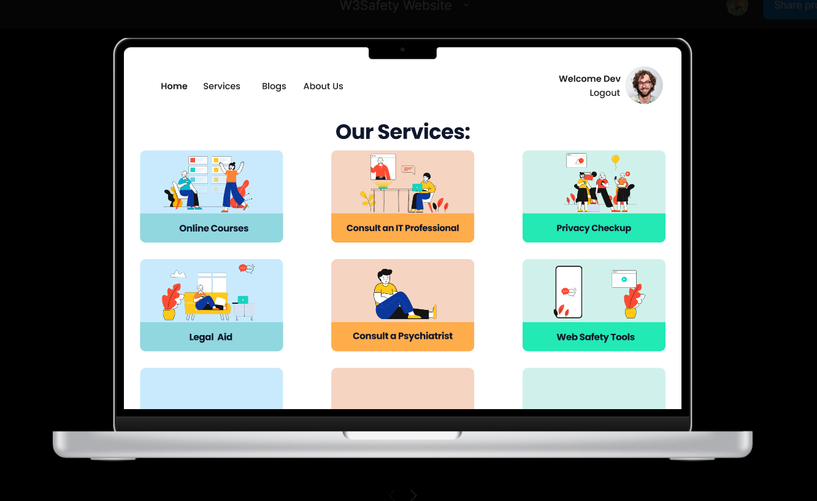

Slide 6
Features
Awareness Events
Privacy Checkup
Web Safety Tools
Consult an IT professional
Consult a Psychiatrist
Legal Aid

Slide 7

Impact
On Users

Slide 8
How our services help our Users
Collecting and documenting evidence
Utilising reporting tools in online platforms
Avoiding
retaliation with the
perpetrator
Seeking help if needed

Slide 9
User benefits
How to react
Users will be equipped with the knowledge to combat instances of bullying.
Identify Bullies
Users will learn to identify instances of harassment and bullying and take precautions
Seek help
In case of queries, users can consult IT Specialists and Psychologists
Awareness
Users will be made aware of their rights and the existing laws of the country
Security
Users will gain a better understanding of how to secure their accounts and private data

Slide 10
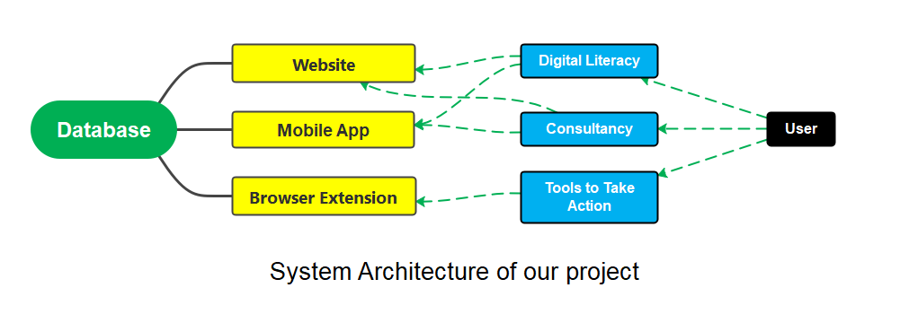
System Architecture of our Website

Slide 11

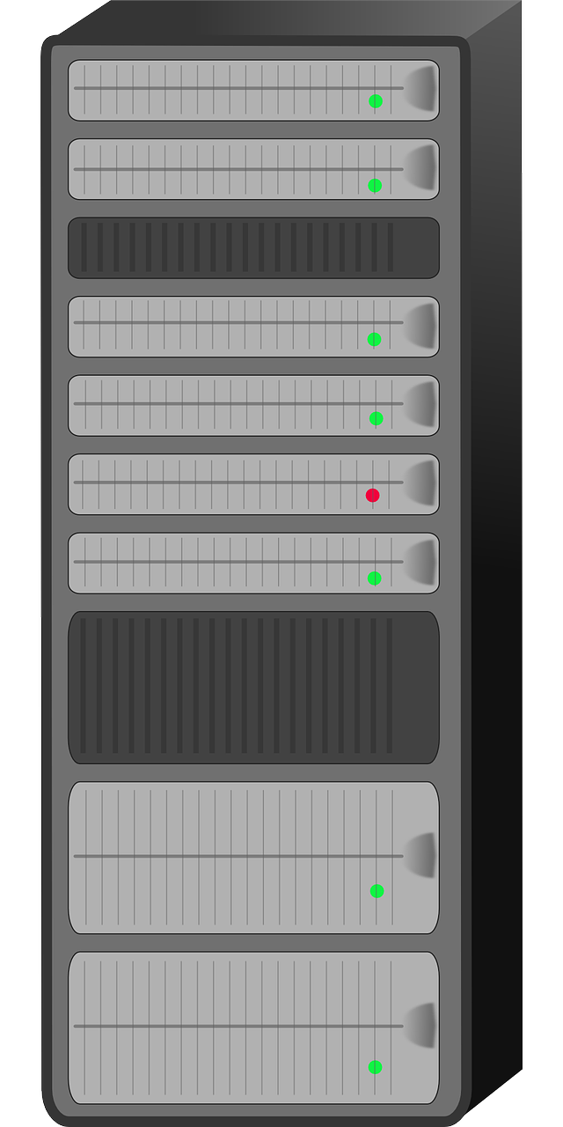


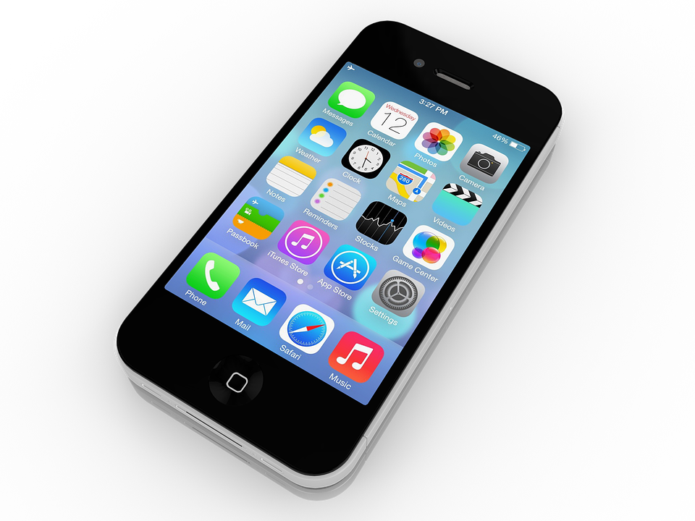
Frontend: React JS, Next JS, SCSS, Tailwind CSS
Backend: Node JS, Express JS, ByCript JS, dotenv, MySQL, JWT
Database: MySQL, Xampp
Client
Server
Database
API
System Architecture

Slide 12

Marketing Strategy
How we will promote our products?
Social Media Posts
Promotional Videos
Offline Event on Institutions
Collaboration with Influencers

Slide 13
Business Model Canvas
Partners
Activities
Values
Relationships
Customers
Government Institutions
Educational Institutions
Brands, Companies
Raising Awareness
Social Media Posts
Arranging Events & Contests
Community Support
Consultancy
Legal Aid
Effective measures to ensure cyber safety
Psychological Assistance
Legal Assistance
Online Courses
Cyber Safety Tools
Consultations
Live Chat
Social Media Groups
Customer Support
Certificate
Students
Parents
Organisation
Professionals
Individuals
Resources
Revenues
Costs
Channels
Freemium
Partnership with other Brands
Online & Offline Training
Online Courses
Funding
Content Developers
Volunteers / Campus Ambassador
Employees
Website, Apps & Tools Maintenance
Content Development
Workshops & Online Events
Marketing
Website
Mobile App
Social Media
Offline Events

Slide 14




Funding:
01
Government
Funding
Institutional
Collaboration
02
04
User
Subscription
Brand Partnership
03

Slide 15
Profit Breakdown Samples:
Spread Awareness
Total income
Research & Development
Content Development
Company Fund

Slide 16

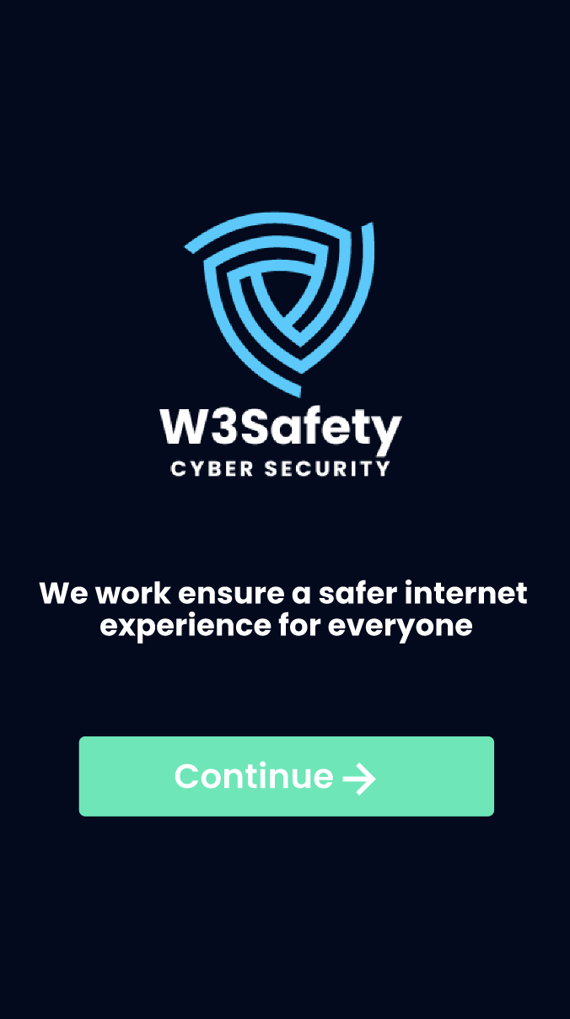


Thank You
Download ‘W3Safety’ to ensure a Safer Internet

